Slide 1

ACS DivCHED New Member Committee
Mary Beth Anzovino
BCCE 2024
Wednesday, July 31st
anzovino@wisc.edu

Slide 2
New Member Committee
Katherine Aubrecht
Rich Bauer
Sridhar Budhi
Mihaela Chamberlin
Aimee Modic
Marc Muñiz
Andri Smith
Jeanette Stewart

Slide 3
NMC Description
The Goal of the New Member Committee is to perform functions and implement and sustain policies, programs, and activities that welcome and meet the needs of new members of the Division of Chemical Education. To help us meet our goal, we encourage new members of the Division to contact the committee chair with ideas for new activities or programs that would help meet your needs.
We (try to) staff the Division poster at National & Regional ACS meetings.
https://divched.org/about-divched/committees-boards/new-member-committee

Slide 4
Needs Assessment for Division Members
Demographic information
Who are our members?
What job roles do they have?
Motivations for membership
Why do members join?
Why do members retain membership?
Areas for improvement
How could the Division communicate better?
What resources could the Division provide?
Note: most items not required, so total N varies

Slide 5
PT college instructor
(12)
Postdoctoral researcher
(5)
Industrial position
(4)
Graduate student
(13)
Administrator
(15)
Other
(22)
Full professor
(71)
FT lecturer/
teaching faculty/
instructional staff
(41)
Emeritus professor
(22)
Precollege teacher
(28)
Assistant professor
(29)
Associate professor
(33)
Notes:
0 undergrads!

Slide 6
Institution Types
4-year
(Doctoral)
(75)
2-year
(37)
Higher Ed
(222)
Precollege
(28)
K–5
(1)
4-year
(Master’s)
(22)
4-year
(Bachelor’s)
(88)
9–12
(27)

Slide 7
Institution Types
Other
(6)
Charter
(2)
Private
(112)
Public
(150)

Slide 8
Some other race
(4)
Black or African American
(8)
Hispanic or Latino
(18)
Multiple races
(2)
Asian
(22)
Not Hispanic or Latino
(248)
White
(231)
Notes:
No American Indian/Alaska Native, no Native Hawaiian/Pacific Islander

Slide 9
Duration of Membership
5 or fewer
(54)
5 or fewer
(101)
≥ 16
(98)
≥ 16
(159)
11–15
(26)
6–10
(29)
11–15
(38)
6–10
(33)
ACS
DivCHED

Slide 10
Notes:
PD greatest interest

Slide 11
What information do you wish the Division was better at communicating to its members?
Travel awards, general awards
Professional development opportunities
Funding opportunities
Service opportunities (CHED committees, ACS Exams)
Resources for teaching
Services & value provided to members
Networking opportunities

Slide 12
What services do you wish the Division offered to help support you as a professional?
Collaborative research opportunities
Financial support for meeting attendance
Support for folks to transition to chemistry education research (workshops, certifications)
Integration with AACT (American Association of Chemistry Teachers)
Networking opportunities/learning communities
Teaching materials
Notes:
Chem Ed Xchange!

Slide 13
Other Comments/Thoughts
Perception of an “in crowd” as a barrier to engagement
Website clarity is an issue
Micro-programming/micro-volunteering as a first step
New leadership/fresh perspectives would be welcome
It seems there is untapped potential/will to serve among our membership!

Slide 14
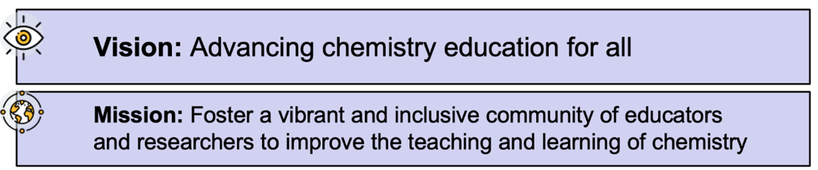
ACS DivCHED Strategic Plan (2024)
Goal 1: Engagement & Inclusivity
Create 3 social networking opportunities by Fall 2025 National Meeting
Goal 2: Professional Development
Implement 3 new professional learning programs by Q3 2025 (secondary practitioners, postsecondary practitioners, chem ed researchers)
Goal 3: Identifying & Communicating Value
Inventory of at least 15 DivCHED resources by Fall 2025
Notes:
G1S2: Programs & Events: Networking (teaching ideas, assessment ideas, research collaborations)
G2S1: Professional Learning: chem ed research how-to, PUBLICATIONS in J Chem Ed
G3S3: Resources: database of research expertise

Slide 15
Looking Forward
Work with division leadership & other committees to implement strategic plan initiatives
Continue conversations with members
Ways to improve communication & value
Engage & get feedback from newer/earlier-career folks
Better publicize resources that are already available
Many don’t require division membership to access…but dues help keep them available!

Slide 16
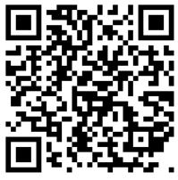
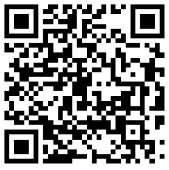
What are your thoughts?
View information about
DivCHED strategic plan
Express interest in
DivCHED activities/committees
(And would you like to join the NMC next year?)
Mary Beth Anzovino anzovino@wisc.edu
Notes:
QR code

